Slide 1
FPHL Expansion
Prepared by Tony Kibling
April 25, 2021

Slide 2
Agenda
Objective
Demographics: Jackson
Dining and Shopping
The Players
Deciding Factor
Why not Racine?
Next Steps
Recap

Slide 3
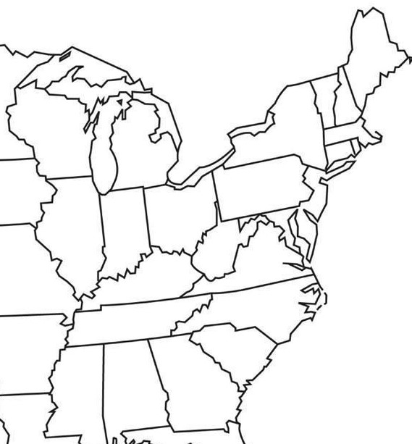
Objective
Expand Western Division
Want a thriving small town
Population growth
Income growth
Dining options
Shopping
Two choices
Jackson, MI or Racine, WI
Port Huron Prowlers
Racine, WI
Jackson, MI
Battle Creek Rumble Bees
Danville Dashers
Carolina Thunderbirds
Columbus River Dragons
Image source: https://images.app.goo.gl/ioPgqxo48zShYDM38
Adapted by Tony Kibling
Notes:
The Federal Prospects Hockey League (FPHL) is committed to providing quality family entertainment at affordable prices in some of the most exciting new and established hockey markets in North America. This is the current state of teams in the western division. There are two teams in Michigan with plenty of room for one more. For reference, the eastern division teams are shown but not labeled.

Slide 4
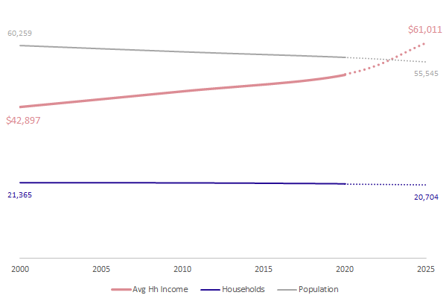
Income, Households, and Population
Jackson, MI (area)
Data source: Gale Business Demographics April 15, 2021
Totals for Jackson (area) include Jackson, Blackman Township, and Summit Township
Adapted by Tony Kibling
Notes:
The FPHL would like a community with a stable or growing population and income. Although the Jackson area shows a decline in population, it’s still a thriving community with over 55000 residents. Despite the population decreasing, the number of households remains relatively flat. Over the past 20 years, the average household income continues to rise and is projected to keep growing.

Slide 5
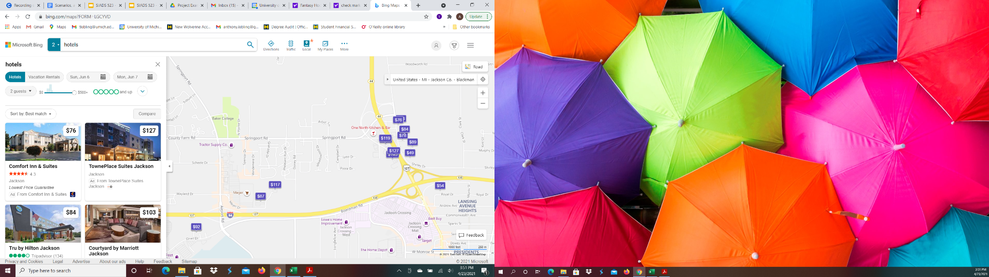
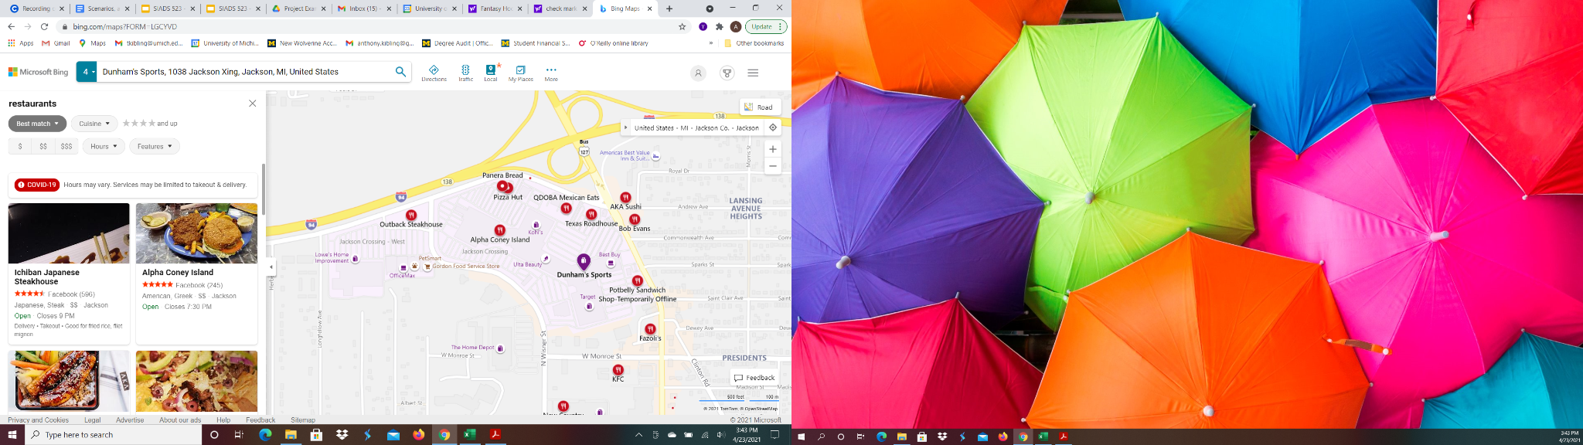
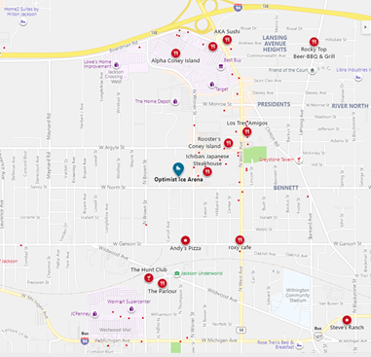
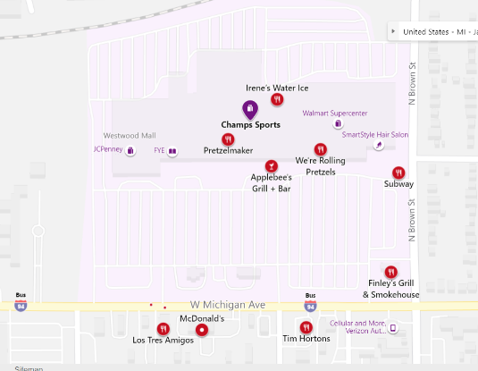
Hotels
Restaurants & Shopping
Image source: bing.com/maps
Notes:
We need things for fans to do and there should be some local dining establishments. There are two shopping centers in Jackson, both have a variety of shops and both have sporting goods stores. The residents in this area spend 6% of their income eating out and 40% of that on dinner. There are plenty of hotel options for out of town guests as well.

Slide 6
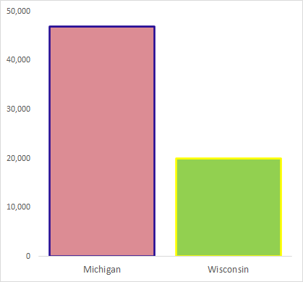
More than 2x registered hockey players in Michigan
Data source: USA Hockey
Adapted by Tony Kibling
Notes:
In addition to fans, in order to field a hockey team, we need players. The state of Michigan has more than two times the number of hockey players registered with USA Hockey than Wisconsin. With another team, these players can stay close to home.

Slide 7
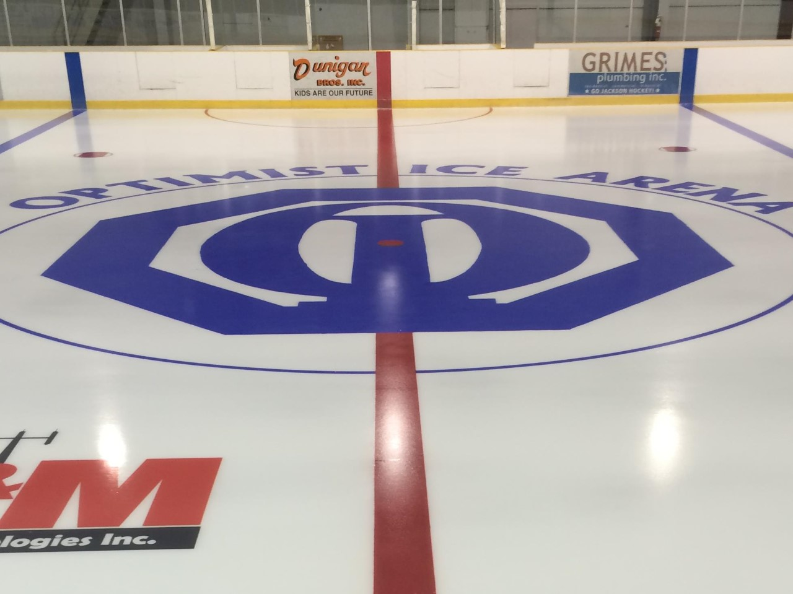
Optimist Ice Arena
Notes:
Lastly, the team needs a place to play. Optimist Ice Arena was the home to the minor pro hockey team, the Jackson All-Americans, that played 1986-1989. The arena and city has already experienced the excitement of a league but not our league yet.

Slide 8
Why not Racine?
Demographics
Population declining
Households constant
Growing income
Consumer Data
Similar spending habits
Geography
Fewer hotels
Shopping centers
Restaurant varieties including fast food and pizzerias
On Lake Michigan enables waterfront activities.
No arena, no team
Nearest hockey arena is 15 miles away

Slide 9
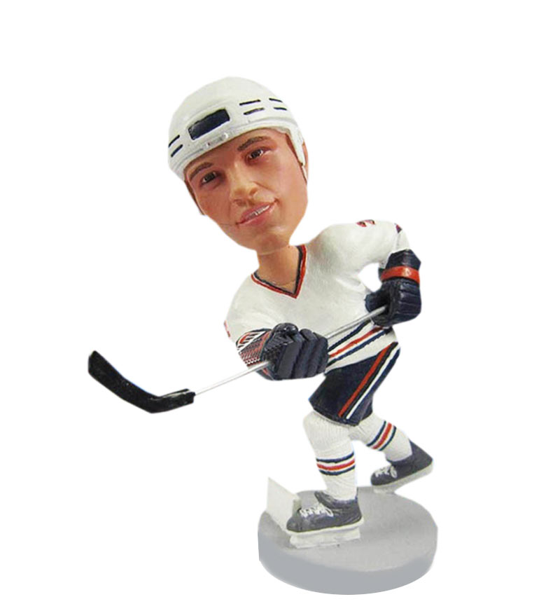
Next Steps
Lease negotiations
More seating
Upgrade concessions
Fundraising and Sponsorships
Create logo and produce fan gear
Notes:
Current seating capacity at Optimist Ice Arena is limited to some bleachers on one side of the ice and standing room. There is also a snack bar. Most arenas in the league have a seating capacity >3,000. However, a couple are smaller including the Watertown Wolves (Syracuse). They play in a 1,500 seat area.
Contact local businesses for sponsorship opportunities such as CMS Energy which has their headquarters in downtown Jackson. This can consist of sponsoring a seating section, advertising on merchandise for game day giveaways (bobbleheads, keychains, etc.), and doing events (teddy bear toss or chuck a puck).

Slide 10
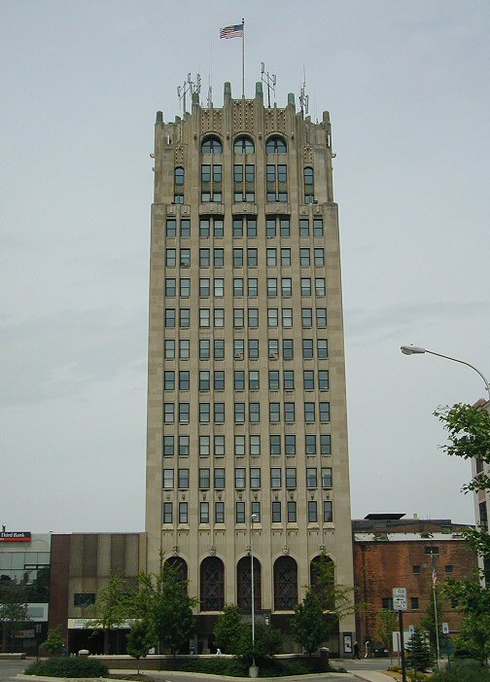

Recap
 | Jackson
Growing Population
Income Growth
Dining and Shopping
Existing Hockey Arena
Questions?
Tony Kibling
tkibling@umich.edu
Jackson County Tower, Jackson’s tallest building
By Original uploader was Criticalthinker at en.wikipedia - Transferred from en.wikipedia to Commons., CC BY-SA 3.0, https://commons.wikimedia.org/w/index.php?curid=3392227
Notes:
As I have stated today, Racine and Jackson have similar metrics. Neither Jackson nor Racine have a growing population; however, household numbers remain steady, income is growing and consumers are spending. Both have a variety of restaurants, retail and hotels. In the end, there is an existing facility in Jackson that previously hosted a minor league hockey team which gives it a leg up on Racine.
The state of Michigan is a proven home for hockey and Jackson will be a great home for the next FPHL team.

